Slide 1



Pizza Sales Report
View in Power BI
Last data refresh:
27/05/2025 06:30:11 UTC
Downloaded at:
24/03/2026 03:02:28 UTC

Slide 2
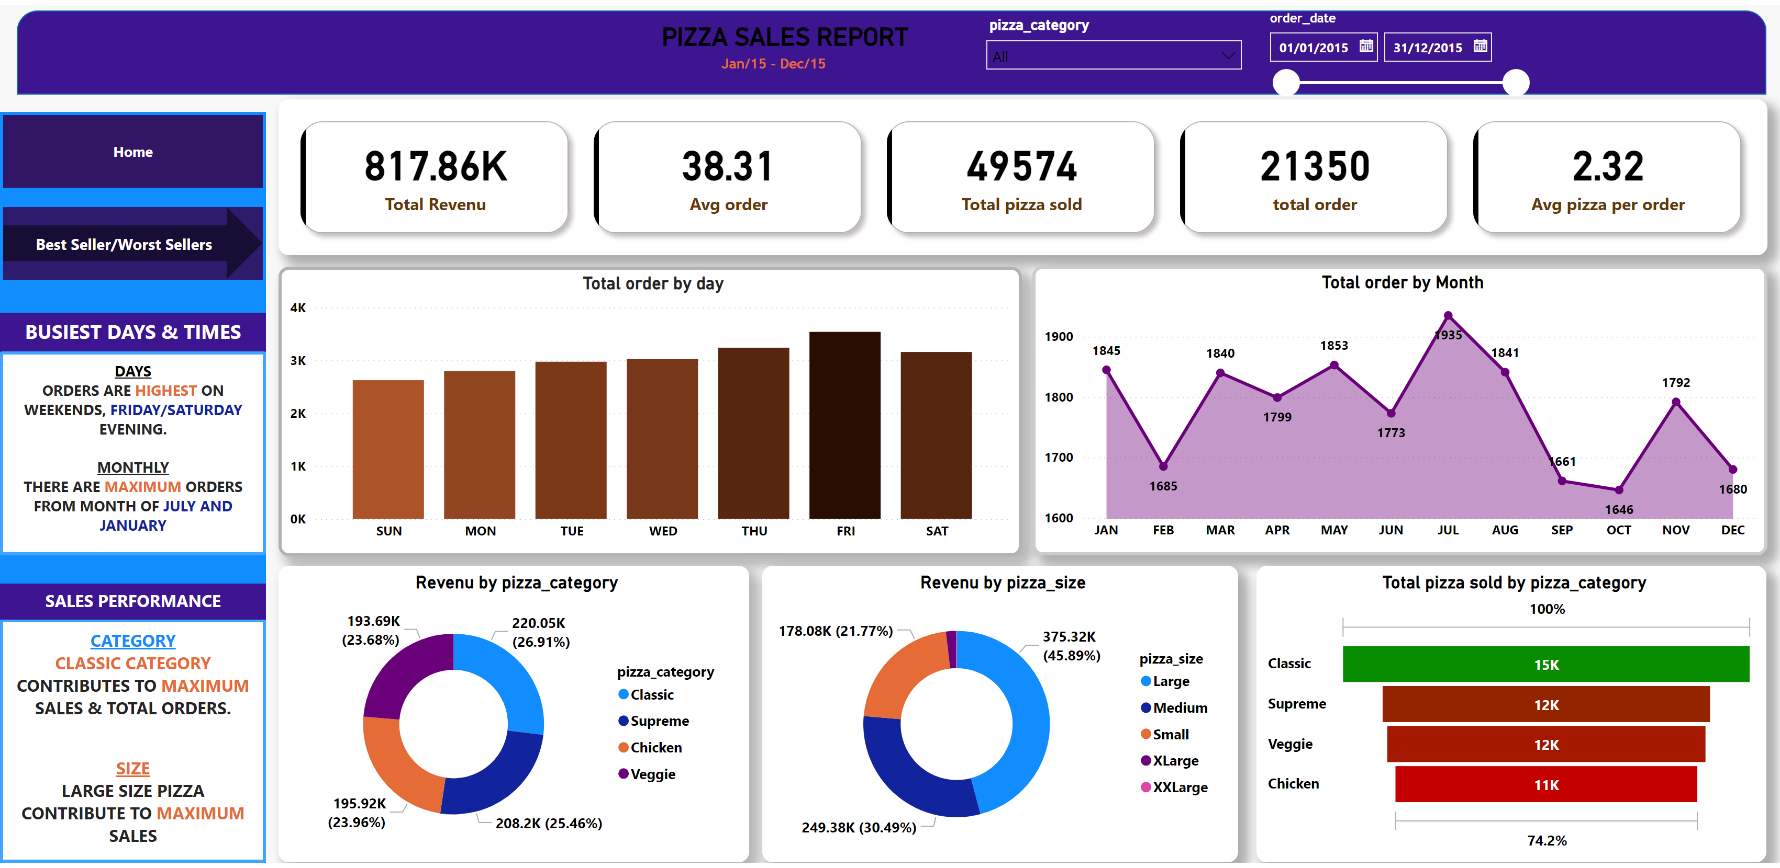
Home
Notes:
cardVisual
No alt text provided
shape
No alt text provided
textbox
No alt text provided
textbox
No alt text provided
Total order by day
No alt text provided
Total order by Month
No alt text provided
Revenu by pizza_category
No alt text provided
Revenu by pizza_size
No alt text provided
funnel
No alt text provided
shape
No alt text provided
textbox
No alt text provided
textbox
No alt text provided
textbox
No alt text provided
textbox
No alt text provided
slicer
No alt text provided
slicer
No alt text provided
pageNavigator
No alt text provided
pageNavigator
No alt text provided

Slide 3
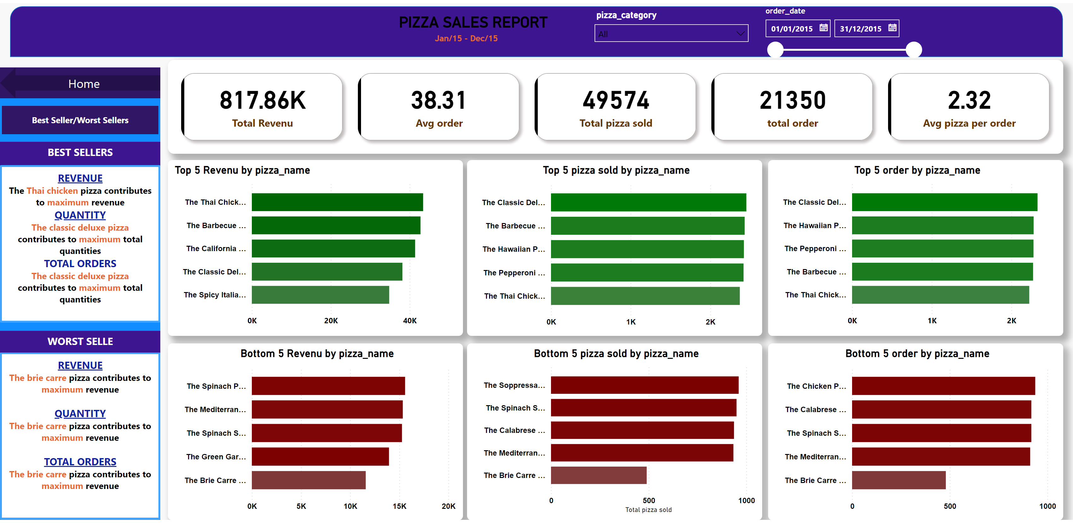
Best Seller/Worst Sellers
Notes:
cardVisual
No alt text provided
shape
No alt text provided
textbox
No alt text provided
textbox
No alt text provided
shape
No alt text provided
textbox
No alt text provided
textbox
No alt text provided
textbox
No alt text provided
textbox
No alt text provided
slicer
No alt text provided
slicer
No alt text provided
Top 5 Revenu by pizza_name
No alt text provided
Top 5 pizza sold by pizza_name
No alt text provided
Top 5 order by pizza_name
No alt text provided
Bottom 5 Revenu by pizza_name
No alt text provided
Bottom 5 pizza sold by pizza_name
No alt text provided
Bottom 5 order by pizza_name
No alt text provided
pageNavigator
No alt text provided
pageNavigator
No alt text provided

